Slide 1

Identifying Risk through Customer Transaction: XGBoost Technique in Supply Chain Finance
Guided by
R. Saravanan,
AP-I / SOC
Presented by
Lakshmi Sri Lasya T (125156063) , CSE(AI&DS)
D Krishna Venkat Chowdary (125156161), CSE(AI&DS)
Sree Lalitha Ratna Tejaswi K (125015118) , IT

Slide 2
Base Paper
Base Paper Title: Financial risk prediction in supply chain finance based on buyer transaction behavior
Journal Name: Decision Support Systems
Year of Publication: 2023
Publisher Name: Elsevier
Base Paper Link : https://www.sciencedirect.com/science/article/pii/S0167923623000398

Slide 3
Introduction
Supply Chain Finance (SCF) is a type of supplier finance that enables the supplier to serve their receivables earlier than the actual payment date, thereby freeing up its working capital and also benefits the buyer as the buyer can obtain short-term credit at a lesser cost. Delayed payments by buyers pose a significant threat to supply chain stability. Thus, identifying potential supplier liquidity is crucial.

Slide 4
Literature Review
Sl . No | Paper Title | Technique Used | Merits | Limitations
1 | C. Blome, T. Schoenherr, Supply chain risk management in financial crises—a multiple case-study approach, Int. J. Prod. Econ. 134 (1) (2011) 43–57, | CAPM and NPV, Credit Risk Prediction using historical data, Reverse Factoring | Profitability and Value, Long-term Relationships, Generous Payment Terms for suppliers | Incomplete Risk Indicators, Neglect of Specific Risks, Over emphasis on Delay

Slide 5
Literature Review
Sl. No | Paper Title | Technique Used | Merits | Limitations
2 | E. Adida, H. Mamani, S. Nassiri, Bundled payment vs. fee-for-service: impact of payment scheme on performance, Manag. Sci. 63 (5) (2016) 1–19, | Combination of APS,NPS,DPS, Stackelberg Model, Blockchain-Based Smart Contracts, Data-Driven Modelling | Short-Term Financing, Cash Flow Management, Strategic decisions based on pricing and profit | Delayed Payment from Large Buyers, Suppliers may not be identifying proper customers, Lack of generalizability due to data-driven approach

Slide 6
Literature Review
Sl. No | Paper Title | Technique Used | Merits | Limitations
3 | X. Chen, X. Wang, D.D. Wu, Credit risk measurement and early warning of SMEs: an empirical study of listed SMEs in China, Decis. Support. Syst. 49 (3) (2010) 301–310 | Modified KMV Model with tuning parameters, two credit warning lines (DD = 40 and DD = 30) foe credit crisis in SMEs, Default Distance (DD) as a measure for credit risk prediction. | Stability in Predictive Accuracy, warning lines (DD = 40 and DD = 30) provided a practical tool for monitoring crises | Limited generalization Focused on the years 2004 to 2006, Limitation in data availability
07-03-2024
6

Slide 7
Data Set
The payment practices dataset from the
https://check-payment-practices.service.gov.uk/export
The dataset consists of 77681 entries and 23 attributes.
Data is from the UK government website
07-03-2024
7

Slide 8
Problem Statement
Supply Chain Finance is prone to risk with delayed payments and hence analysis, identification and assessment of imperative reasons are crucial for smooth transactions.,

Slide 9
Objective
This work addresses this issue by developing a finance risk prediction model using XGBoost and examined by customer transaction behavior.
In this work there will be a comparative analysis for risk assessment using various machine learning algorithms like Random Forest, Gradient Boosting Decision Tree (GBDT), and LightGBM.

Slide 10
Methodology
Step 1: The payment practices dataset is imported and preprocessed to remove noise.
Step 2: Exploratory data analysis is applied to understand the features’ dependencies and relations.
Step 3: Payment behaviour of customers are used as variables and the dependent variable target is identified.
Step 4: Identify imbalance in the data and apply random sampling.

Slide 11
Methodology
Step 5: The payment practices dataset is split for training and testing
Step 6: XGBoost, Random Forest (RF), Gradient Boost Decision Tree (GBDT) , LightGBM, XGBoost + LR, RF + LR, and GBDT + LR are implemented.
Step 7: The performance of applied techniques is evaluated. The outperformed method is used for financial risk assessment.
Step 8: Web based tool is developed to explore effectiveness and accessibility.
07-03-2024
11

Slide 12
Hardware and Software Requirements
Hardware:
4GB RAM
256GB external memory
Software:
Google Colab
Python

Slide 13
System Architecture / Flow diagram of the work
Data Pre-processing
Splitting data
Load
payment-practices
dataset
Data
Applying Pareto-principle
Handling missing data by mice-imputer
Target generation by feature engineering
Test
Train
Models
Re –sampling
Techniques
Evaluation Metrics
XGBoost
F1-Score
Random Forest
Random Over
AUC
GBDT
Deployment
Using
Web Page
Random Under
LightGBM
ROC
XGBoost+LR
SMOTE
10-fold cross-validation
RF+LR
GBDT+LR
07-03-2024
13

Slide 14
Modules
Module 1: Data Preprocessing and Target generation
Module 2: Implementation of single models
Module 3: Implementation of hybrid models
Module 4: Deployment of the model
07-03-2024
14

Slide 15
Module 1 Data Preprocessing and
target generation
Step 1: Current data and old data according to base paper are loaded.
Step 2:Pareto principle [80:20] is applied on data and observed 80th percentile as 51.
Step 3: Now data is cleaned which involves handling missing values.
Step 4: Iterative imputer from fancy impute module is used to handle both categorical and numerical data
07-03-2024
07-03-2024
15
15

Slide 16
Module 1 Data Preprocessing and
target generation
Step 5: Feature engineering is done to create a flag value based on values of ‘% Invoices not paid within agreed terms’ and 80th percentile.
Step 6: Correlation matrix is constructed and highly correlated features are dropped.
Step 7: Data is now split for training and testing. 70% for training and 30% for testing. This is done using train_test_spilt from sklearn module.
Step 8: Data is balanced by re-sampling technique, RandomOverSampler from imblearn
07-03-2024
07-03-2024
07-03-2024
16
16
16

Slide 17
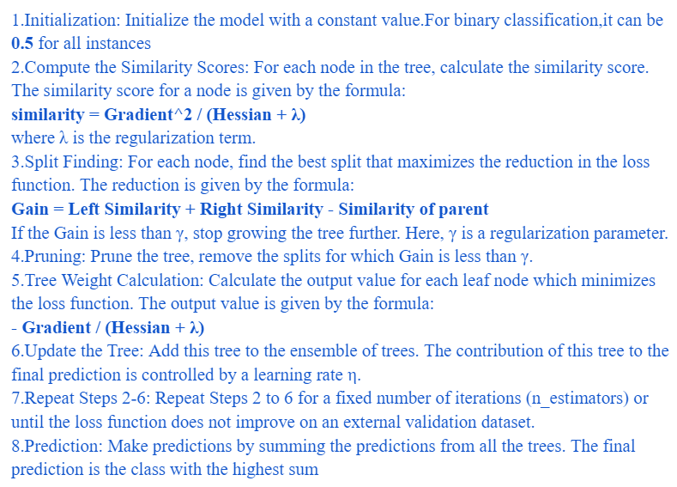
Module 2 Implementation of single models
Step 9: XGBoost algorithm is implemented. XGBoost is a machine learning algorithm that belongs to the ensemble learning category, specifically the gradient boosting framework. It utilizes decision trees as base learners and employs regularization techniques to enhance model generalization.
07-03-2024
07-03-2024
17
17

Slide 18
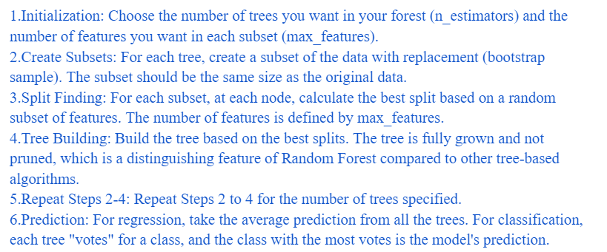
Module 2 Implementation of single models
Step 10: Random forest is a commonly-used machine learning algorithm, that combines the output of multiple decision trees to reach a single result. The random forest algorithm is an extension of the bagging method as it utilizes both bagging and feature randomness to create an uncorrelated forest of decision trees.
07-03-2024
07-03-2024
07-03-2024
18
18
18

Slide 19
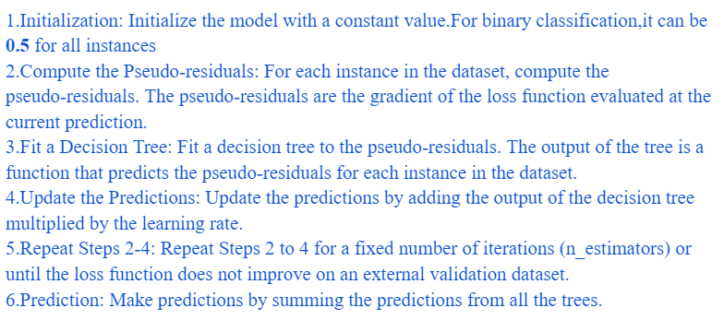
Module 2 Implementation of single models
Step 11:Gradient-boosted decision trees are a machine learning technique for optimizing the predictive value of a model through successive steps in the learning process. Each iteration of the decision tree involves adjusting the values of the coefficients, weights, or biases applied to each of the input variables being used to predict the target value, with the goal of minimizing the loss function. The gradient is the incremental adjustment made in each step of the process.
07-03-2024
07-03-2024
07-03-2024
19
19
19

Slide 20
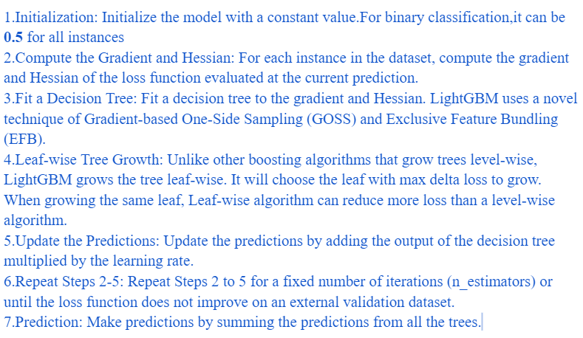
Module 2 Implementation of single models
Step 12: LightGBM is a gradient-boosting framework based on decision trees to increase the efficiency of the model and reduce memory usage.
It uses two novel techniques: a) Gradient-based One Side Sampling(GOSS) b)Exclusive Feature Bundling (EFB). These techniques fulfill the limitations of the histogram-based algorithm that is primarily used in all GBDT (Gradient Boosting Decision Tree) frameworks. The two techniques of GOSS and EFB form the characteristics of the LightGBM Algorithm.
07-03-2024
07-03-2024
07-03-2024
07-03-2024
20
20
20
20

Slide 21

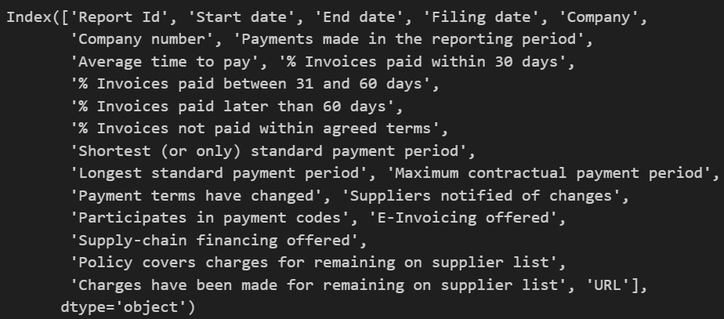
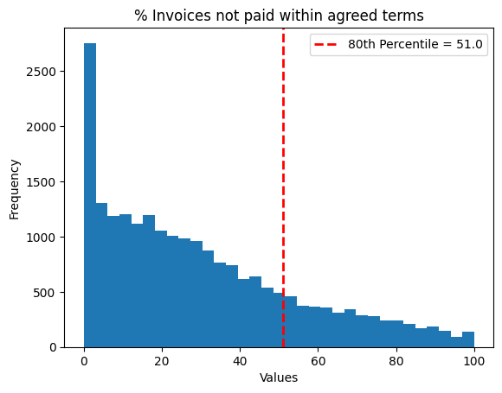
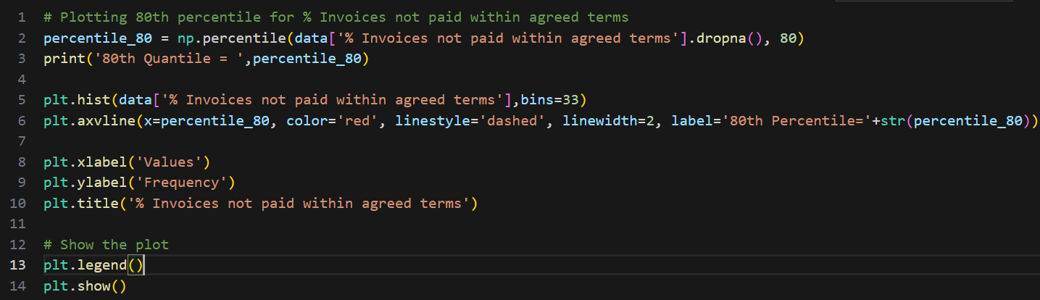
CODE & RESULTS
For steps 1 to 8:
Pareto Principle:

Slide 22
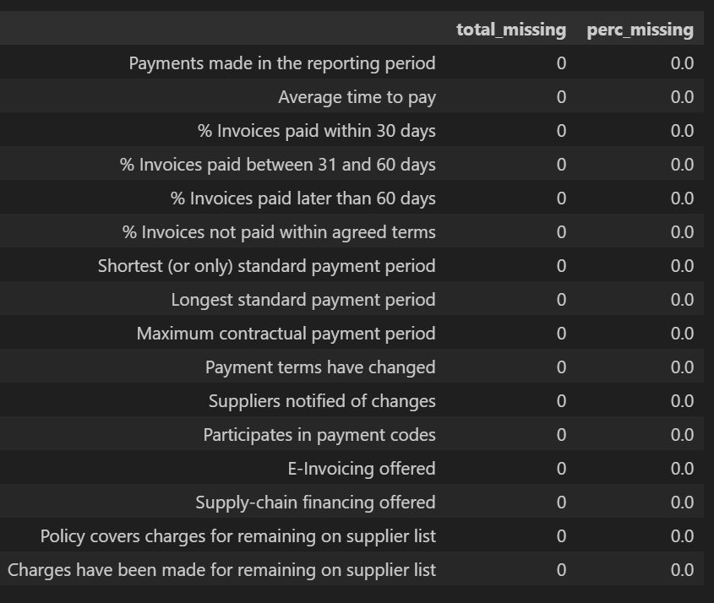
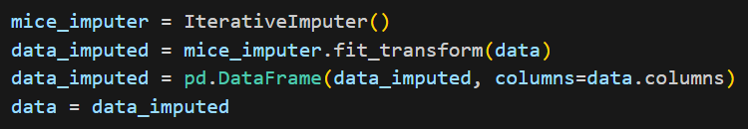
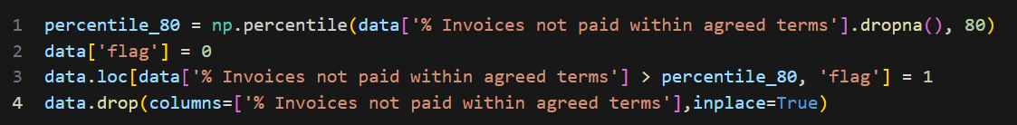
CODE & RESULTS
Imputing missing data:
For Target Variable generation:

Slide 23
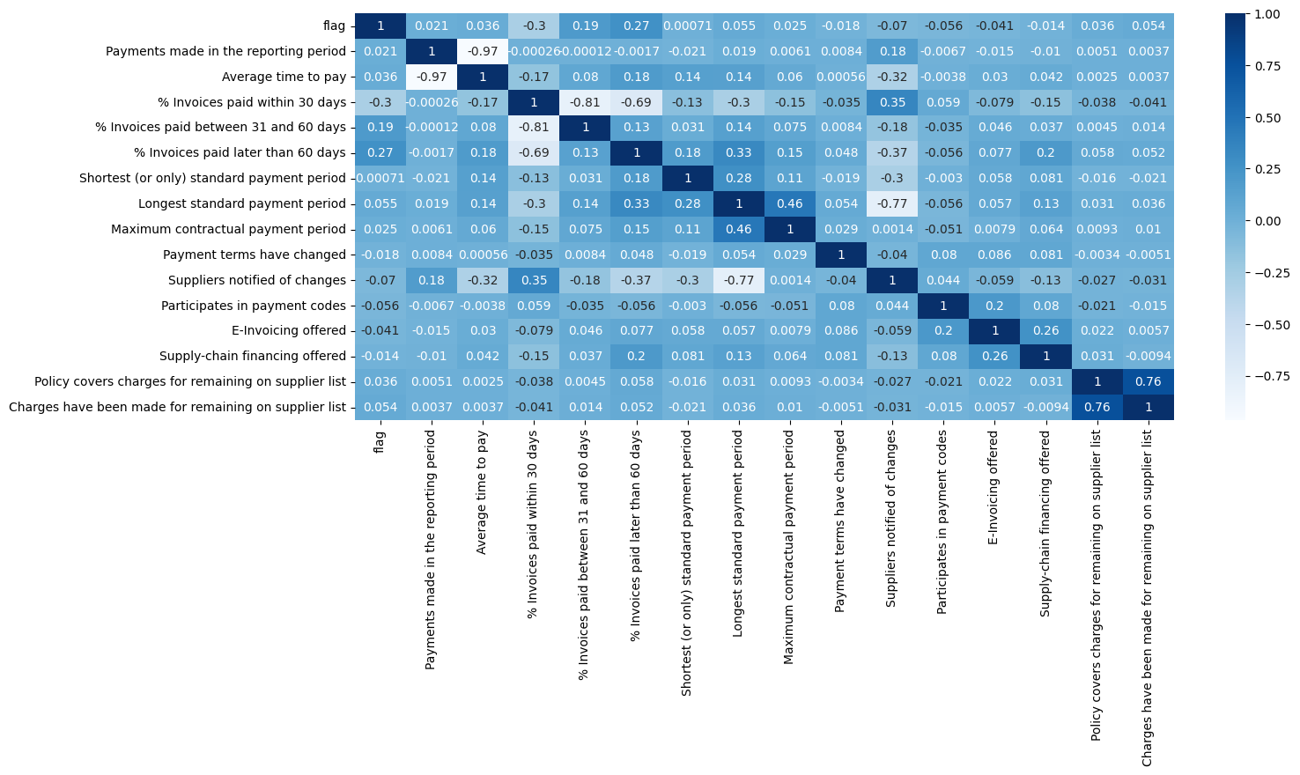
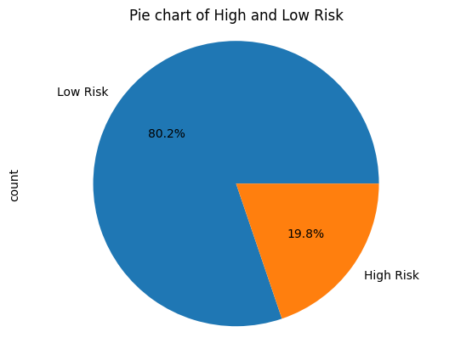
CODE & RESULTS
Correlation Plot
Checking balance in data after train-test-split

Slide 24
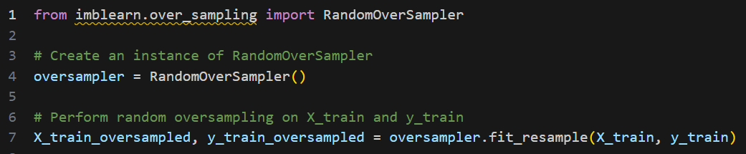
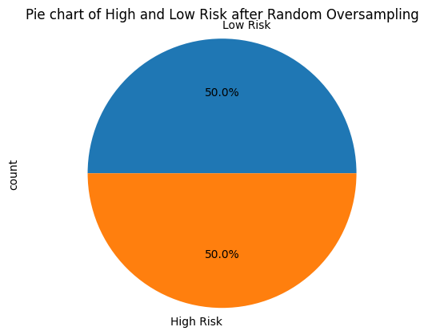
CODE & RESULTS
Re-sampling:

Slide 25
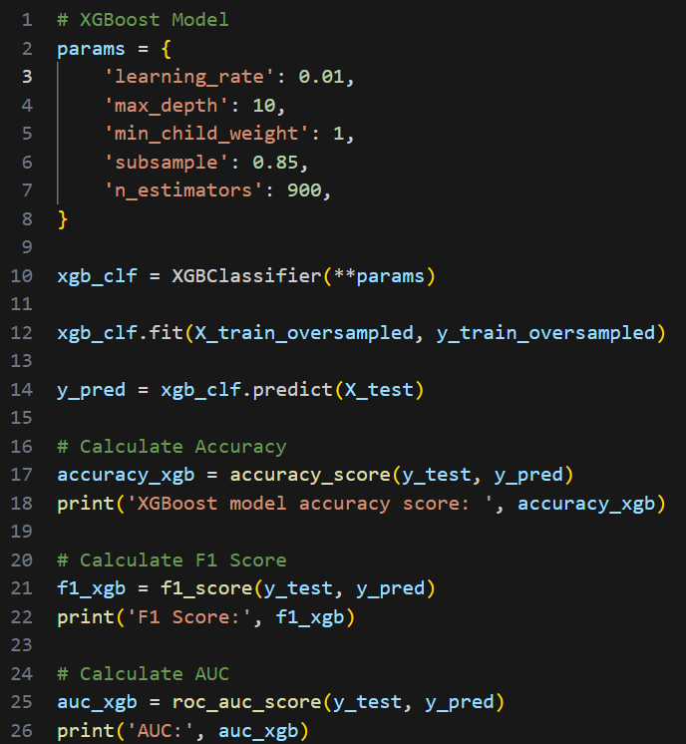
CODE & RESULTS
For step 9:

Slide 26
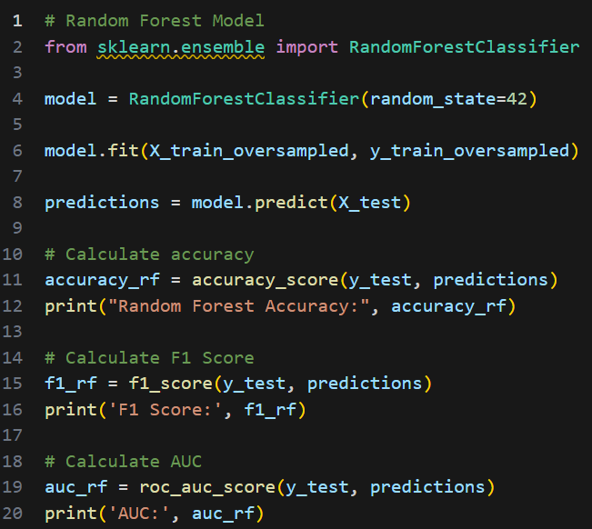
CODE & RESULTS
For step 10:
07-03-2024
26

Slide 27
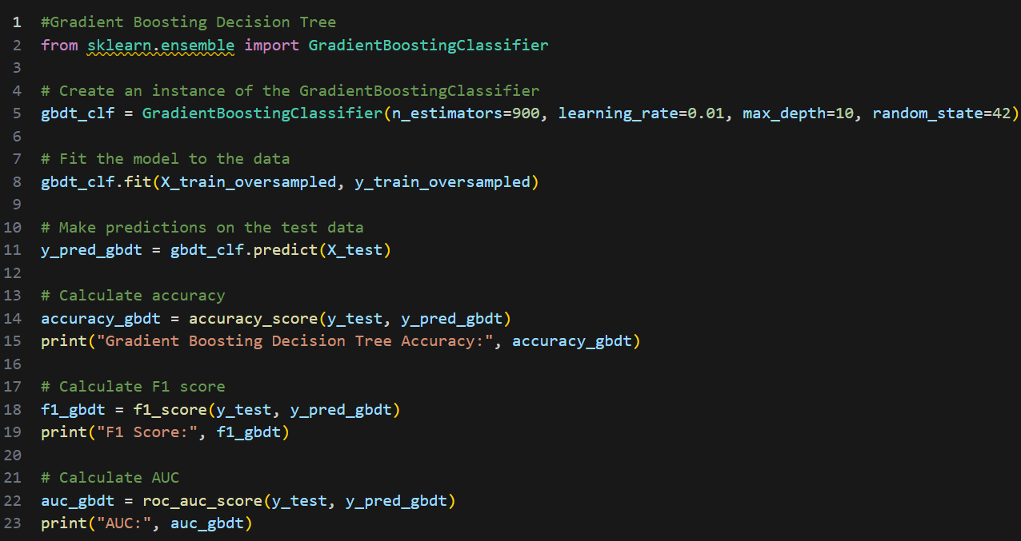
CODE & RESULTS
For step 11:
07-03-2024
07-03-2024
27
27

Slide 28
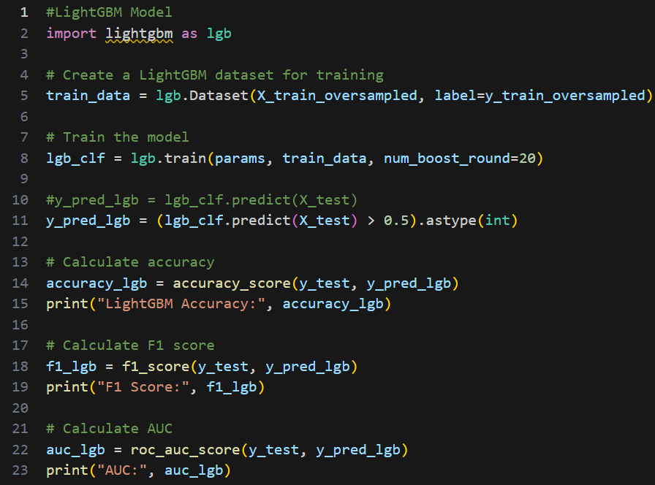
CODE & RESULTS
For step 12:
07-03-2024
07-03-2024
28
28

Slide 29
CODE & RESULTS
For step 12:
07-03-2024
07-03-2024
07-03-2024
29
29
29

Slide 30
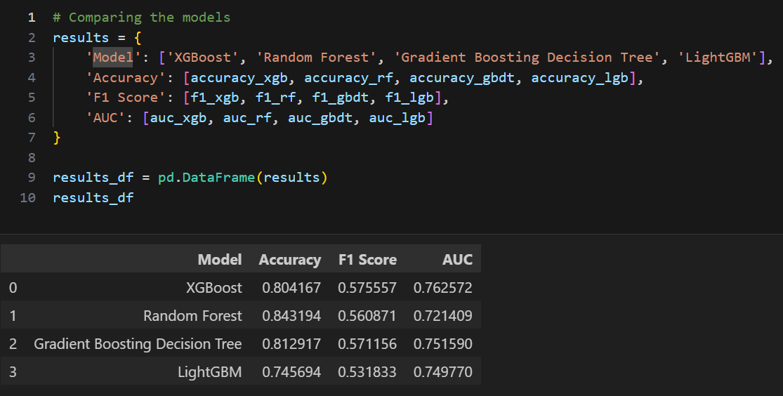
CODE & RESULTS
Comparative Analysis on old data:
07-03-2024
07-03-2024
07-03-2024
30
30
30

Slide 31
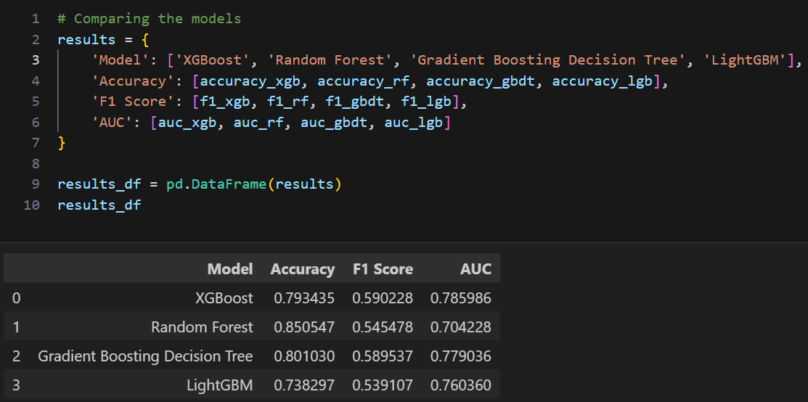
CODE & RESULTS
Comparative Analysis on new data:
07-03-2024
07-03-2024
07-03-2024
07-03-2024
31
31
31
31

Slide 32
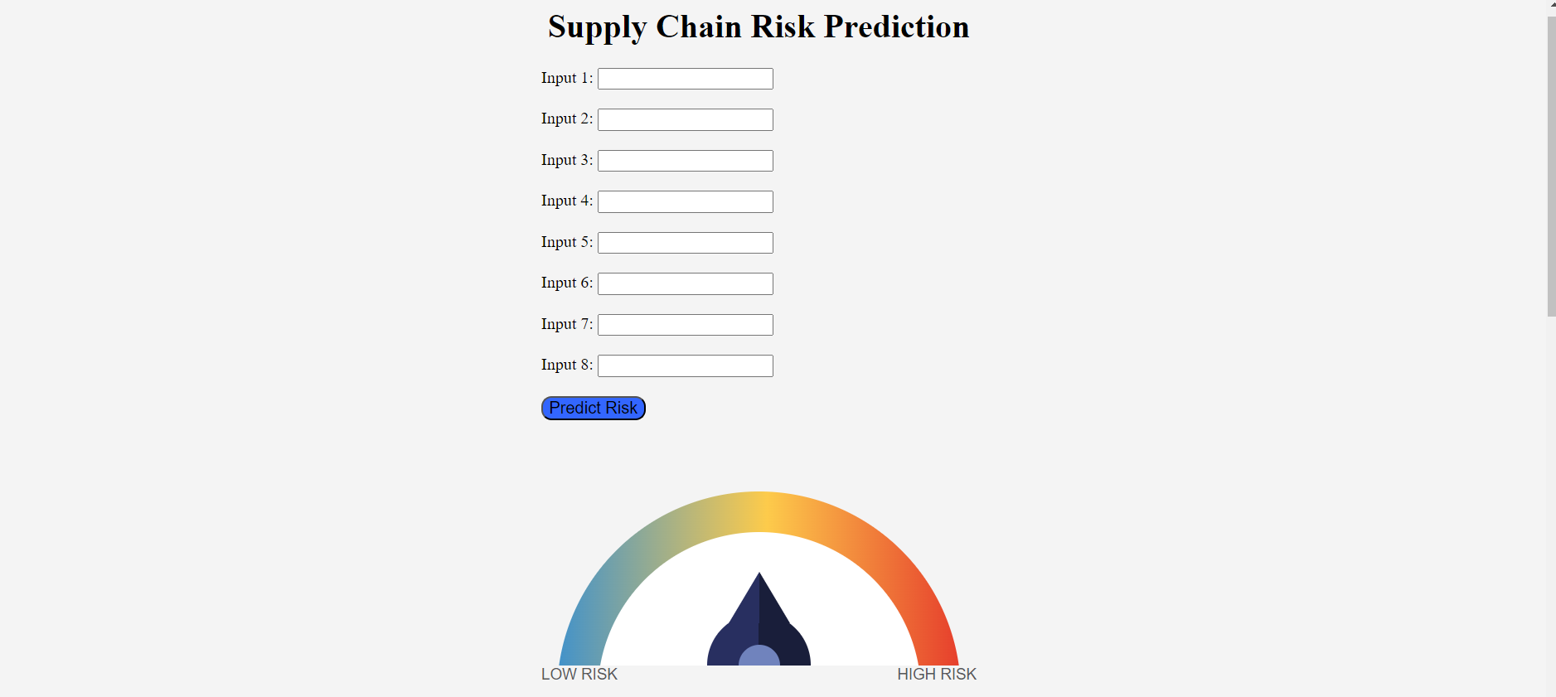
CODE & RESULTS
Web Page Template:
07-03-2024
07-03-2024
07-03-2024
07-03-2024
07-03-2024
32
32
32
32
32

Slide 33
Work Plan
Review Period | Work Particulars | % of Work Completed
Zeroth Review | Base paper Confirmation Problem identification Hardware and Software Requirement Analysis | -
First Review | Literature Review System architecture design Module identification Proposed Algorithm implementation | 40%
Second Review | Proposed algorithm implementation Comparative Analysis Providing risk assessment | 100%

Slide 34
References
E.Adida, H.Mamani, S.Nassiri, Bundled payment vs. fee-for-service:impact of payment scheme on performance, Manag. Sci. 63 (5) (2016) 1–19
F. Aqlan, S.S. Lam, A fuzzy-based integrated framework for supply chain risk assessment, Int. J. Prod. Econ. 161 (2015) 54–63
M. Bai, Y. Qin, Short-sales constraints and liquidity change: cross-sectional evidence from the Hong Kong market, Pac. Basin Financ. J. 26 (2014) 98–122
M. Bahrami, B. Bozkaya, S. Balcisoy, Using behavioral analytics to predict customer invoice payment, Big Data 8 (1) (2020) 25–37
G.E.A.P.A. Batista, R.C. Prati, M.C. Monard, A study of the behavior of several methods for balancing machine learning training data, ACM SIGKDD Explor. Newsl. 6 (1) (2004) 20–29

Slide 35


